Slide 1
Cryptocurrencies and Crime
Dom Hobson
Dom.hobson@soton.ac.uk

Slide 2
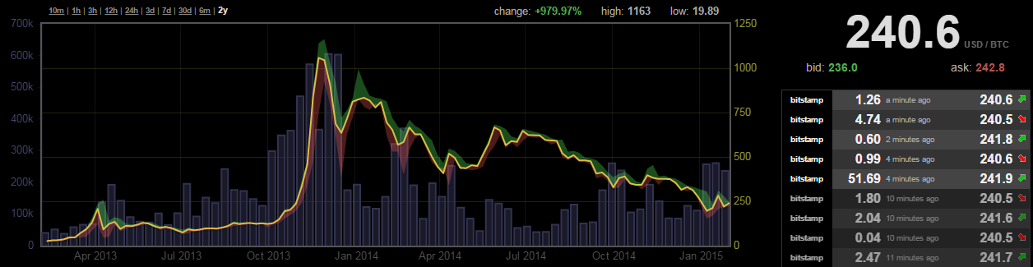
Cryptocurrencies
Bitcoin
Created by pseudonym Satoshi Nakamoto 2008/2009
Maximum of 21 million “bitcoins” (BTC) to be produced
Currently 25BTC every 10 minutes
1 bitcoin costs as much as people are willing to pay:

Slide 3
Cryptocurrency Features
Decentralised
“No central point of failure”
In both the context of technology and management
Blockchain - ledger of all transactions between addresses
Non-reversible
Privacy considerations
Governed by code
Potential for democratic fiscal policy
Appealing to certain ideals

Slide 4
Cryptocurrency Features
Open Source
Anyone can contribute to code
Anyone can copy or reproduce any or all of Bitcoin
Protocol
Described a set of rules for behaving
Anyone can create software to implement rules
Ecosystem
Relies on a host of other services for trading
Other services not so secure

Slide 5
Activity
“What illegal, deviant or otherwise nefarious things could you do with cryptocurrencies?”

Slide 6
Some Crimes
Purchasing illegal goods or services
Drugs
Guns/Hitmen
Counterfeits
Theft
Malware
Targeted hacking
Money laundering/tax evasion
Fraud:
Ponzi schemes
No product scams

Slide 7
More dodgy things!
Funding illegal causes
Terrorist groups etc.
Breach of trade embargoes
Sales of unregistered shares or securities
Distribution of illegal material
Child abuse image
Wikileaks
Ransoms

Slide 8
Regulating money
Cryptocurrencies fall between the laws:
For Electronic Money Directive to apply, must:
Have electronic storage
Issued on receipt of funds
Acceptance as a means of payment by others
For Payment Services Directive to apply:
Must not issue currency

Slide 9
Laundering/Tax evasion
Authorities seem most worried about this.
“It costs everyone”
Basic stages in laundering:
Placement – get it in the system (e.g. drug funds maybe small bills needs to be lump sums)
Layering – mix up the money, hide it’s trail
Integration – get the money to it’s final destination from a seemingly legal source
Cryptocurrencies can be useful for any of these stages

Slide 10
Anti-Money Laundering law
Anti Money Laundering/Know Your Customer (AML/KYC) laws are intended to reduce laundering.
Rely on knowing your customer
Identifying customers and businesses properly
Monitoring transactions (SARs)
Risk management
+ Cryptocurrencies: Can see all transactions & business!
- Cryptocurrencies: Ideals, and technology not geared towards identification.

Slide 11
New York BitLicence
“Businesses that receive, transmit, store or convert virtual currency for customers; buy and sell virtual currency as a customer business; control, administer or issue a virtual currency; or perform conversions between bitcoin and fiat or any value exchange will need to be licensed to operate in New York. ”
Background check for all employees + founders
Fingerprints of the above submitted to FBI
Capital bond held by NY State
Written approval from NY State for all new business offerings
10 years of transaction records required.

Slide 12
How to police cryptocurrencies?
Community attempts self policing where possible:
BitcoinTalk “Scam accusations” Board:
https://bitcointalk.org/index.php?board=83.0
http://goo.gl/bfQzED
Activity: Have a look at the board, and some threads. Anything interesting?

Slide 13
Conclusions
Cryptocurrencies are similar to lots of things, but different to everything we know of.
Many current regulatory frameworks unsuitable
Unenforceable
Clash with ideals
Lots and lots of unknowns with cryptocurrencies, technically, economically and socially.
Are cryptocurrencies a symptom of wider socio-political issues?

